Slide 1
Mining and Mineral Resources

Slide 2
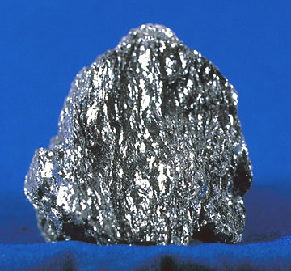
Nonrenewable Mineral Resources
Earth crust = Minerals + rock
Minerals –inorganic compound that occurs naturally in the earth’s crust
  Solid
  Regular internal crystalline structure.
Rock – solid combination of 1 or more minerals.

Slide 3
Mineral Resource: Any mineral useful to humans
  Metallic Minerals: Iron Oxide, Gold
  Non-metallic mineral: Limestone, sand
  Fossil Fuel; Coal, Petroleum
Ore: A rock that can be profitably mined for a mineral (often a metal) or for minerals (metals)
  High Grade Ore; has high concentration of the mineral
  Low Grade Ore: smaller concentration
Gangue: Minerals other than ore present in a rock

Slide 4
Types of Metals
Abundant Metals: concentration >0.1% in the earth’s crust
  Iron, Aluminum, Silicon, Magnesium, Titatnium, Manganese
Scarce Metals: <0.01% in the crust
  Ferro-alloys: Nickel, Chromium
  Base Metals: Copper, Lead, Zinc
  Precious or Noble Metals: Gold, Silver, Platinum
  Special Metals: Gallium, Arsenic, Germanium, Rare earths, Berrylium, Scandium etc..

Slide 5
PBT = Persistent, bio-accumulative and toxic.
  5 nutrient metals: Cu, Cr, Ni, Al, Zn
  6 non-nutrient metals: Sb, As, Be, Cd, Pb, Hg
Metals cannot be banned and are present in nature, in soil, in food and in water
Pb, Cd, As and Hg pose special problem

Slide 6
Highly Uneven Distribution
S Africa | 50% Gold 75% Chromium 90% Platinum Group
USA | 50% Molybdenum 15% Lead
Chile | 30% Copper
Cuba | 40% Nickel
Guinea and Australia | 25% each of Aluminum
Zaire | 50% cobalt

Slide 7
Mineral Supply and Demand
World Scenario:
  Assumptions:
    Present demand = present production
    Future projection is based on constant 1995 figures
    Unrestricted distribution
  Iron, Aluminum, Chromium, Cobalt and Platinum will last centuries
  Copper, Lead, Zinc, Gold and Silver will last several decades only
  Ditto for phosphates and sulfur
Alleviating Factors:
  More exploration
  Better technology
  Reclassification of sub-economic resources to reserve

Slide 8
Other options
Reduce consumptions
  Smaller households, more leisure and travel, convenience, status etc. make it unlikely even in developed economies
  New technology adds to the existing needs e.g., cellular phones, computers, microwave oven
  In the US, population grew by 65% and consumption grew by 130% between 1950-1990
  Great demand for resources in the developing countries where there is a genuine need and where the great majority lives
If demand cannot be reduced, supplies must be increased or extended

Slide 9
New Methods in Exploration
Geophysics
Geochemistry
Remote sensing: Landsat
Better understanding of geology
Marine Mineral Resources
  sea water, placers, hydrothermal deposits (Red Sea Mud),
  Manganese Nodules(Mn, Cu, Ni, Co, Pt)
  International Law of the Sea Conference

Slide 10
Conservation
Substitution
  Increases consumption of the substituting metal or nonmetal (often petroleum) which itself might be limited in amount
Recycling
  In USA 60% of lead, 40% of copper, 1/3rd of nickel and almost ¼ of Al, Cr, Co and Zn is recycled
  Recycled Al requires 20 times less energy than new Al
  Difficult to do with finished products like cars or fridges
  Special problem with alloys
  Road salt, fertilizers, lead in gasoline gets too disperse
  Reduces waste disposal problem

Slide 11
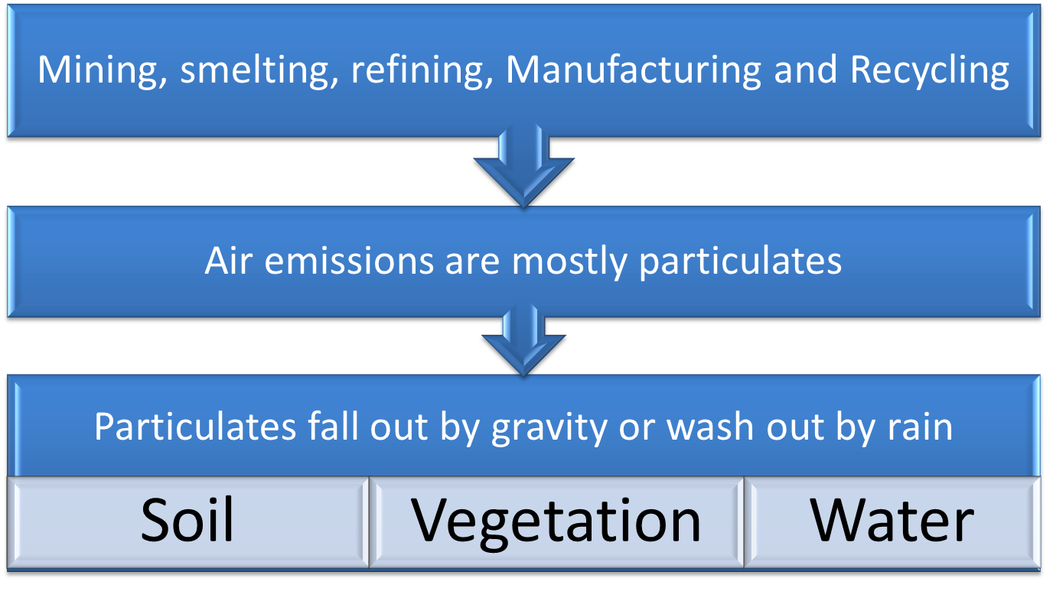
Metals are emitted in air during…

Slide 12
Impact of Mining Activities

Slide 13
Mining Hazards
Most hazardous activity in the US:
Activity | Deaths per 100,000 workers (1989)
Mining | 43
Agriculture | 40
Construction | 32

Slide 14
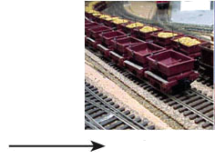
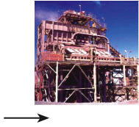
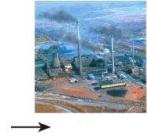
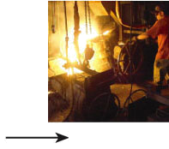
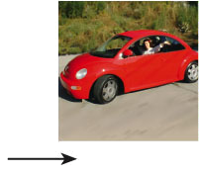
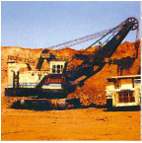
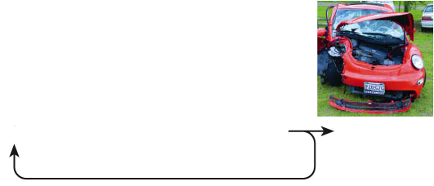
Life Cycle of a Metal Resource
Surface
mining
Metal ore
Separation
of ore from
gangue
Smelting
Melting
metal
Conversion
to product
Discarding
of product
Recycling
Smelting – heating to release metals but creating air polluting by-products
Chemical removal processes such as using cyanide to remove gold can create Toxic holding ponds
Notes:
Figure 12.7: Life cycle of a metal resource. Each step in this process uses large amounts of energy and produces some pollution and waste.

Slide 15
Surface Mines
Open pit mines
  Where large 3D ore body lies close to the surface
  Leaves a large exposed hole on the surface
  Exposed rocks prone to weathering and polluting
Strip mines
  Mostly for coal where minerals occur in layers paralleling the surface
  Waste rocks dumped back as spoil banks
  Newer regulations require reclamation involving grading, restoring, and replanting
  Can cause changes in topography and drainage

Slide 16
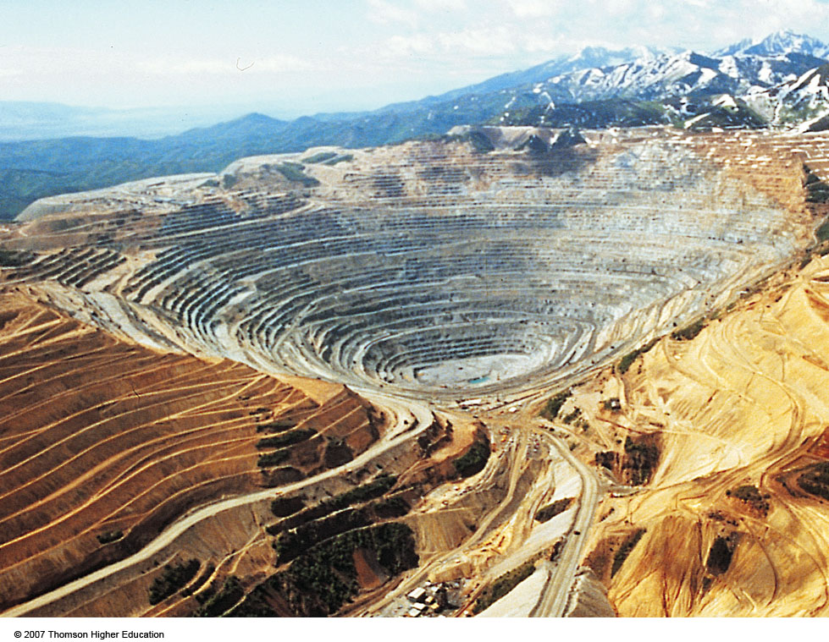
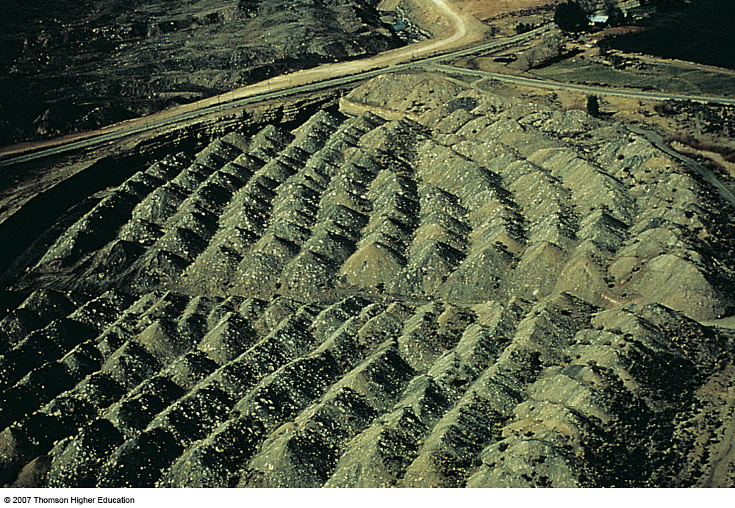
Extracting Mineral Deposits
Surface mining - shallow deposits
in US extracts 90% of non-fuel minerals and rocks and 60% of the coal.
  Overburden – soil and rock overlying deposit.
  Spoils – discarded overburden
Open-pit Mining
Area Strip Mining

Slide 17
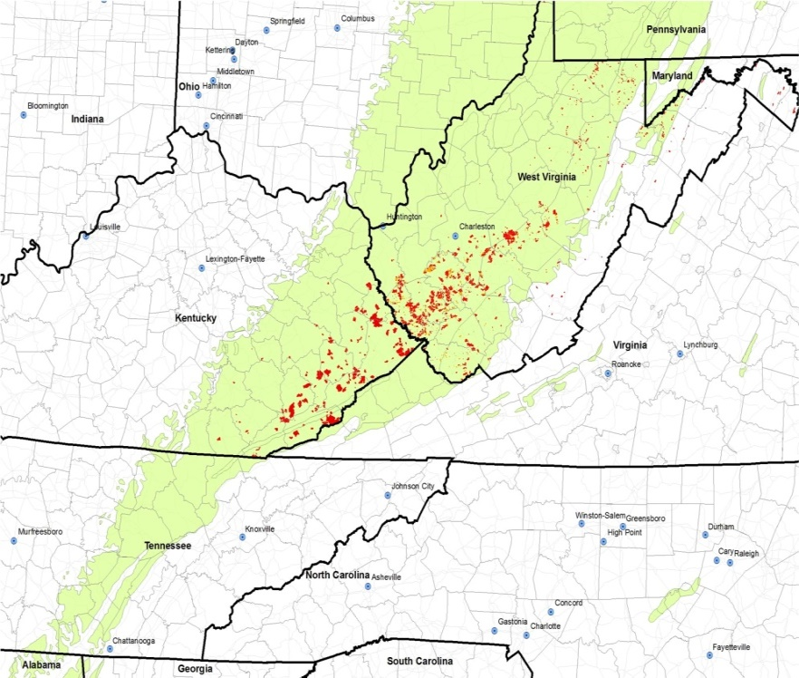
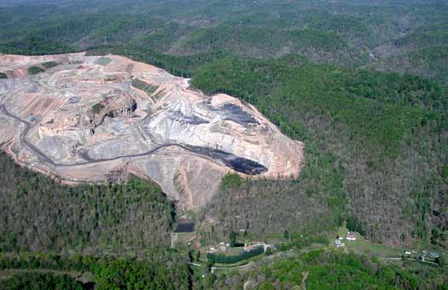
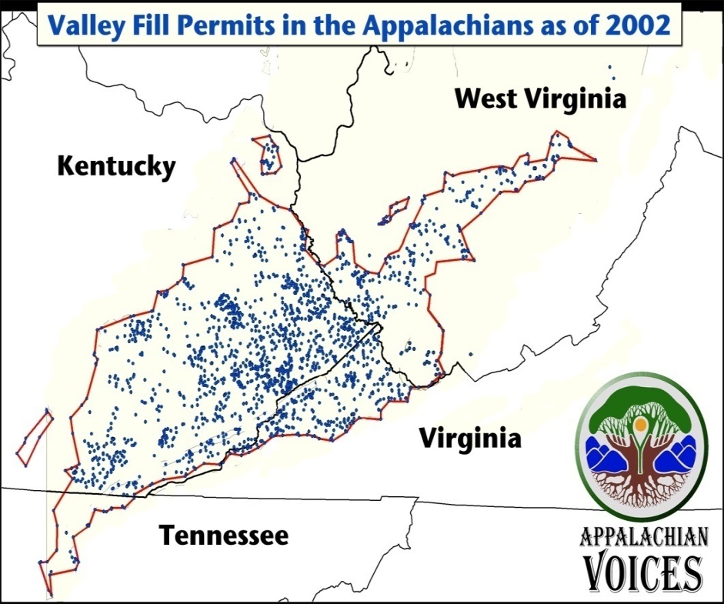
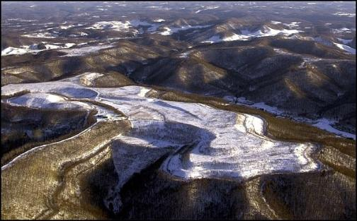
Mountaintop Removal
Figure 15-14

Slide 18
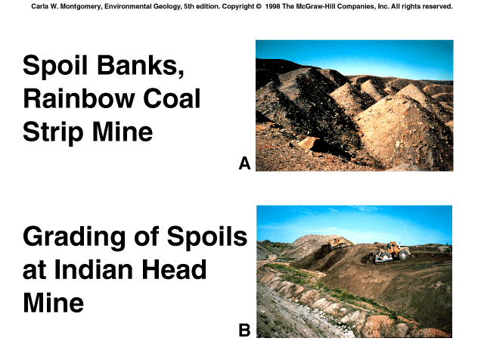

Slide 19
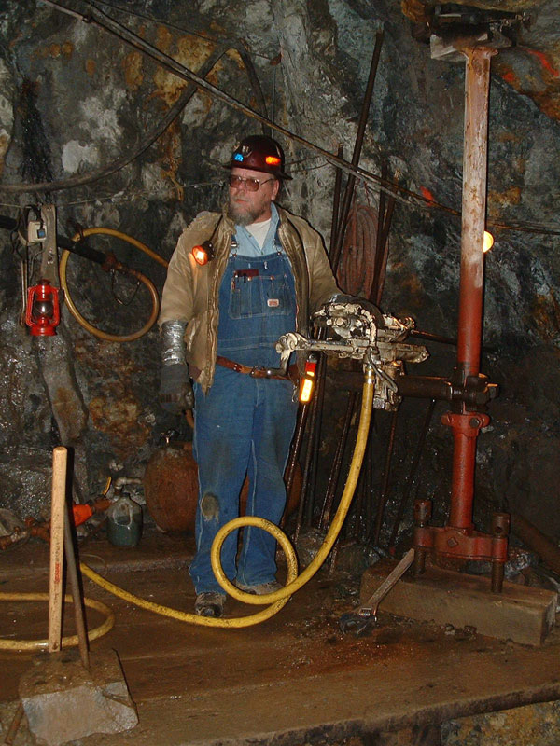
Extracting Mineral Deposits
Subsurface mining - deposits that are too deep for surface mining
  Disturbs less
  produces less waste
  but also less effective and dangerous.

Slide 20
Underground Mines
Generally less disruptive than surface mines
Tunnels closely follow the ore body
Some waste rock on the surface
Shallow abandoned mines can cause collapse

Slide 21
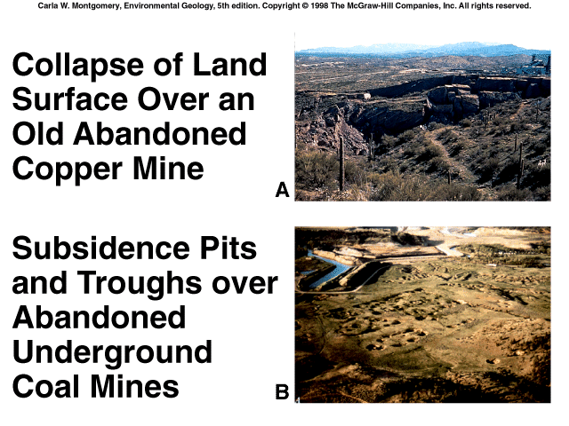

Slide 22
Sources of Metal Pollution
Mining
  Air
  Water
  Land
Fossil Fuel Combustion
  Air
  Water
  Land
Other sources
Natural Sources

Slide 23
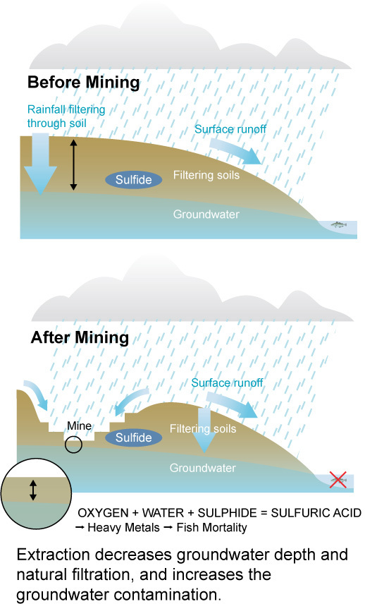
Harmful Environmental Effects of Mining
Acid Mine Drainage (AMD)
Heavy Metal Contamination
Processing chemical pollution
Erosion and Sedimentation

Slide 24

99 tons of waste for every ton of Copper

Slide 25
Acid Mine Drainage (AMD)
  Sulfur in ores react with water and oxygen to form sulfuric acid which leaks out from the mine
  Thiobacillus ferroxidans bacteria in acid water hastens the process
  Acid is carried off the mine site by rainwater or surface drainage and deposited into nearby streams, rivers, lakes and groundwater. AMD severely degrades water quality, and can kill aquatic life and make water virtually unusable.

Slide 26
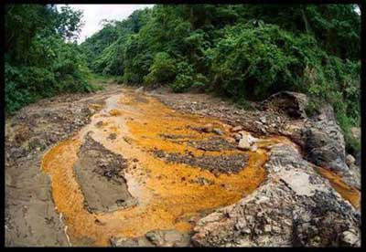
Acid Mine Drainage

Slide 27
2. Heavy Metal Contamination & Leaching
  Heavy metal pollution is caused when such metals as arsenic, cobalt, copper, cadmium, lead, silver and zinc contained in excavated rock or exposed in an underground mine come in contact with water.
  Metals are leached out and carried downstream as water washes over the rock surface.
  leaching is particularly accelerated in the low pH conditions such as are created by Acid Mine Drainage.

Slide 28
3. Processing Chemicals Pollution
  occurs when chemical agents (such as cyanide or sulphuric acid used by mining companies to separate the target mineral from the ore) spill, leak, or leach from the mine site into nearby water bodies. These chemicals can be highly toxic to humans and wildlife.
4. Erosion and Sedimentation
  Mineral development disturbs soil and rock in the course of constructing and maintaining roads, open pits, and waste impoundments.
  erosion of the exposed earth may carry substantial amounts of sediment into streams, rivers and lakes.
  Excessive sediment can clog riverbeds and smother watershed vegetation, wildlife habitat and aquatic organisms.

Slide 29
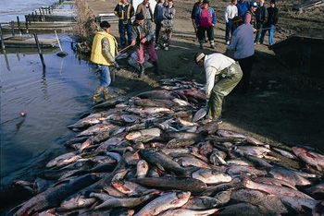
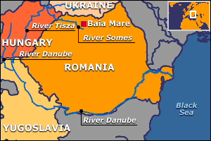
Mineral Processing
Crushing of ores produces tailings
Traces of pollutants like mercury, arsenic, cadmium and uranium may leach out of tailings and contaminate groundwater and landfills
Processing chemicals (e.g., Cyanide) are major hazards (cyanide spill in Danube)
Smelting releases toxic elements, SO₂ etc and causes acid rain which can destroy vegetation

Slide 30
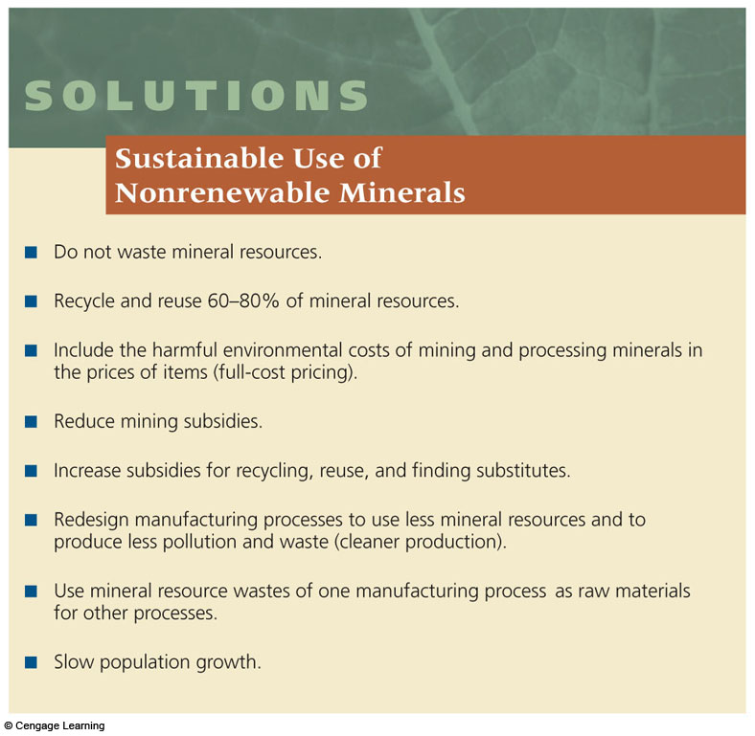
Fig. 12-14, p. 275

Slide 31
Four PBT Metals
PBT: Persistent, Bio-accumulative, Toxic
Lead
Mercury
Cadmium
Arsenic

Slide 32
Lead
Present Scenario compared to 100 yrs ago
  4X in Antarctica Ice
  15X greater in Coral
  500X greater in household dusts
Was used in
  Plumbing
  soldering
  Paint
  Gasoline
  Lead types for printing, Lead in printing ink

Slide 33
Lead; Adverse Effects
Affects Nervous system of human fetus and small children
Most of the lead is stored in bones and along with Calcium, is released in mother’s milk
Affects IQ, causes delinquency, kidney cancer
In adults: High BP, affects nervous system and kidney, anemia, infertility

Slide 34
Sources of Lead
Similar to other metals: mining, smelting, coal burning power plants, incinerators
Lead paints , lead contaminated soil, plumbing
  affects children in poorer households
  Made worse by poor diet low in Ca and Fe
For people living in Lead free environment:
  Food is the major source

Slide 35
Sources of Lead
Gasoline
  Lead level in exhausts fell 90% after banning of lead in gasoline – the substitute, Benzene, is carcinogen
  Lead in the blood of Children fell to 4 -6 microgram/lt (threshold: 10 micrograms/lt)
  Major problem now in China
Incinerator:
P² measures: the following are banned:
  Lead in gasoline, in paint, in printing ink, in solders in plumbing and cans, in sealing wine bottles, in toys
  Imported products can still have lead
  Car batteries still contain lead

Slide 36
Mercury
Much of the mercury in the environment originates as mercury vapor from coal burning power plants and incinerators (2-3000 tons) and from natural sources (2700 to 6000 tons)
Elemental Mercury not as injurious as methylmercury
Most of the mercury ends up in the ocean where bacteria in the bottom sediments convert elemental mercury to methylmercury
Methylmercury biomagnifies up the food chain
  Some game fish has Hg conc. 200,000 X that of surrounding water
  Can cause roblems to humans eating these fish, particularly among children, old people and pregnant women

Slide 37
Adverse effects of Mercury
95% of the exposure comes from eating contaminated fish.
Toxic to nervous system
Minamata Tragedy:
  Chisso Corp discharged mercury in Minamata bay from 1930
  Biomagnification in Fish upto 40 ppm (0.5 ppm safe limit)
  200,000 people were poisoned
  Chronic nervous system damage, miscarriages, deformed fetus
  Settled in 1996 after 30 years of litigation

Slide 38
Reducing Risk from Mercury
Regulations: EPA has set standards for drinking water, air-emissions and is tackling the biggest source: coal burning power plants
Reduce workplace exposure
Reduce or eliminate mercury containing products:
  In rechargeable batteries and button cells
  Remove batteries from municipal solid waste
  Green Lights program: Hg free fluorescent light
  Phase out mercury from hospital and lab products

Slide 39
Cadmium
Discovered in 1817, heavily mined since mid-40s
Bioaccumulates in kidney – increases with age
Itai-itai disease among older women in Japan
Cancer, birth defects in rats
Sources:
  Mining and smelting of Zn, Pb, Cu
  Coal burning
  Phosphatic fertilizers, sewage sludge
  Nicad batteries: a major source in Municipal Solid Waste

Slide 40
Cadmium…
90% of the exposure (of non-smokers) is through food
  Fish, scallops and oysters
  Liver and kidneys of larger animals : beef, venison
  Readily taken up by plants – concentrated in Tobaccos. 90% of inhaled Cd is absorbed by the body
Control: EPA regulations
    Power plants still not controlled
    Nicad batteries still a major problem

Slide 41
Arsenic
Metal smelting of Copper and Lead
Used to be common weed killer
Emitted by volcanoes
Naturally present in soil
  Major environmental problem in Bangladesh
Level in seafoods higher than in land-grown food.
Much of the Arsenic in Food is not bioavailable
CCA (Chromated Copper Arsenate) used to treat wood including playground equipments – can contaminate soil

